Slide 1

IPL 2023 StatsBot: Transforming Data Access
Revolutionizing Data Insights with AI and Natural Language Processing
AI-powered chatbot for IPL statistics and data analysis powered by Azure Open AI, Python, LangChain, SQL, and Streamlit

Slide 2
Application Details
Application URL: https://iplstatsbot.streamlit.app/
Author: Vinod Dhole
Source Code: GitHub

Slide 3
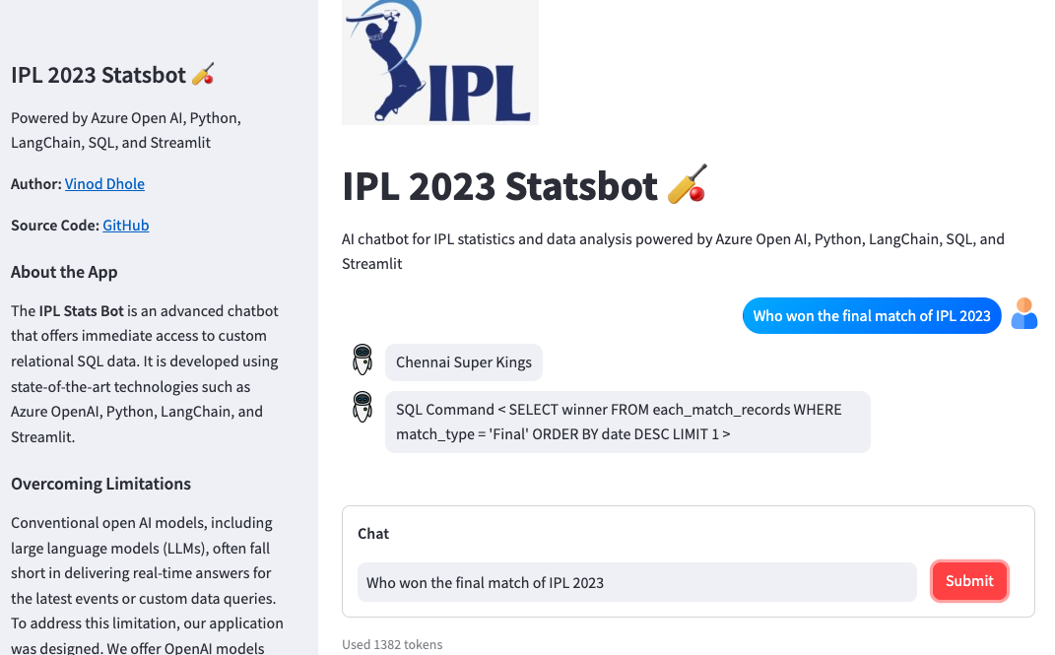
Application Demo

Slide 4
The Goal and The Purpose
Be able to search a SQL database using only natural language.
Enable countless possibilities for data retrieval.
Can be used in the context of businesses and enthusiasts.
Increases the efficiency of gathering data for both data professionals and those who don't understand coding.
Overcome the limitations of the current LLM’s

Slide 5
Current State
Problem Statement:
Traditional open AI models struggle to provide real-time answers on the latest events or custom data queries. Users often require SQL expertise to access data insights from relational databases.
Areas of Impact:
Limitations in delivering up-to-date information.
Lack of custom data access for users.
Dependency on SQL experts for data retrieval.

Slide 6
Technologies
Azure OpenAI
Python
LangChain
Streamlit,
SQL

Slide 7
Future State
Summary of the Solution:
Development of the 'IPL Stats Bot,' an advanced chatbot with real-time capabilities for IPL statistics queries.
Implementation of Natural Language to SQL conversion for user-friendly data retrieval.
Potential extension to other domains and businesses with available data.
Advantage of the Solution:
Immediate access to custom relational SQL data.
Ability to provide real-time answers on the latest events.
Custom data access for users without SQL expertise.
No requirement for prior knowledge of the database structure.

Slide 8
Benefits
Benefits to End User:
Quick and accurate responses to IPL-related queries.
Enhanced user experience.
No need for SQL expertise to gain data insights from relational databases.
Benefits to Support Team App:
Efficient data retrieval and analysis.

Slide 9
Conclusion
The IPL 2023 StatsBot is a game-changer in the world of data access.
It empowers users with real-time, user-friendly data retrieval.
The future holds boundless potential for similar solutions across various domains.

Slide 10
Questions & Answers

